Slide 1
Internet Programming Two
Chapter Three
File and Directory
File and Folder

Slide 2
Objectives
By the end of this chapter, students will be able to:
Understand the purpose and usage of file inclusion in PHP.
Differentiate between include() and require().
Use include_once() and require_once() to prevent redundancy.
Implement file inclusion in PHP scripts.
Utilize PHP built-in filesystem functions for file and directory management.

Slide 3
Understand the Purpose and Usage of File Inclusion in PHP
File inclusion in PHP allows you to reuse code across multiple pages or scripts, making your code more modular, organized, and easier to maintain.
Purpose of File Inclusion
Modularity: Breaks down complex scripts into smaller, reusable components.
Maintainability: Updates in one file can reflect across multiple scripts, reducing redundancy.
Separation of Concerns: Helps organize code by separating logic, layout, and configuration.
To do these PHP has built-in methods such as
include
include_once
require
require_once

Slide 4
Common Website design
Header
Most of the time these header and footer are available in all web pages. So, rather than rewriting those code it is possible to reuse by the help of include or require function.
Main
Footer

Slide 5
PHP include and require functions
The include and require functions are identical, except upon failure:
include() and include_once() produce warnings but allow the script to continue.
require() and require_once() produce fatal errors and halt script execution if the file is not found.
So, if you want the execution to go on and show users the output, even if the include file is missing, use the include statement. Otherwise use require.

Slide 6
Syntax
include 'filename';
or
require 'filename';
In file name it is possible to use relative or absolute path.
Relative paths: Refer to files relative to the current file's location.
Absolute paths: Refer to files using their full path on the server.

Slide 7
include_once and require_once
require_once() and include_once() are useful when you want to ensure that a file is not included multiple times, preventing redeclaration errors.

Slide 8
Example (nav.php)
<a href=’array.php’>Array</a>
<a href=’form.php’>Form</a>
<a href=’fileRead.php’>Read</a>

Slide 9
Inclusion of nav.php
nav.php can be include in any php file of a project like this.
include ‘nav.php’;
Or
require ‘nav.php’;
Or
include_once ’nav.php’;
Or
require_once ‘nav.php’;
For example include nav.php in index.php. At the beginning of index.php
require ‘nav.php’;

Slide 10
PHP built-in functions
PHP provides various functions to handle files and directories:
File Operations:
fopen(), fread(), fwrite(), fclose()
File Information:
file_exists(), filesize(), filemtime()
Directory Operations:
opendir(), readdir(), closedir()
Path Operations:
basename(), dirname(), realpath()

Slide 11
File write
It used to persist data in a file and manipulate dynamically. For example to save Hello World text into hello.txt file works as the following:
Open file using fopen() method. Specify file name and mode
Then use fwrite() method to save at specified location
Lastly close the opened file using fclose() method
$data = “Hello World”;
$fl = fopen('hello.txt','a+');
$write = fwrite($fl,$data);
fclose($fl); //close

Slide 12
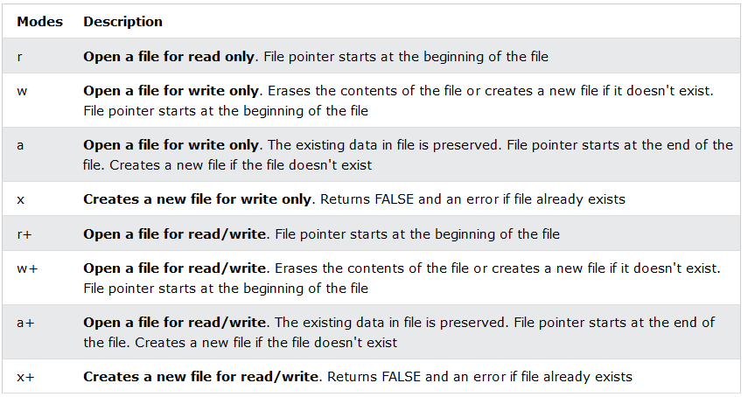
File open modes

Slide 13
Read file
It used to read data from file and manipulate dynamically. For example to read Hello World text from hello.txt file works as the following:
Open file using fopen() method. Specify file name and mode
Then use one of the following functions:
fgets() function is to read a single line from a file.
feof() function is useful for looping through data of unknown length. End-Of-File
fgetc() function is used to read a single character from a file.
Lastly close the opened file using fclose() method

Slide 14
Example 1
$fp = fopen('hello.txt','a+');
if(!$fp)
echo "No file please try again later";
// feof(): function checks if the "end-of-file" (EOF) has been reached
// fgets() function is used to read a single line from a file.
while(!feof($fp)){
$order = fgets($fp,400);
echo $order."<br/>";
echo "-------------------------------------------------------------------------------------<br/>";
}
fclose($fp);

Slide 15
Example 2
// Reading from a file
$file = fopen("example.txt", "r");
if ($file) {
while (($line = fgets($file)) !== false) {
echo $line;
}
fclose($file);
} else {
echo "Unable to open file!";
}

Slide 16
Making Dynamic
To write dynamic data HTML form is one option.
Accept data from form and write into the file
Design a form.(form.php)
Accept and process file writing.(fileWrite.php)
form.php
<form action=”filrWrite.php” method =”POST”>
<textarea name=”remark”></textarea>
<button type=”submit” >Register</button>
</form>

Slide 17
Making Dynamic
fileWrite.php
$data = $_POST[‘remark’];// accept form data
$fl = fopen('hello.txt','a+');//open or create or update
$write = fwrite($fl,$data);// store
fclose($fl); //close
header('location:fileRead.php');

Slide 18
Exercise
Check all file opening modes for write and read from and to the file.

Slide 19
Thanks

